Slide 1
Recycle/Upcycle
Chequamegon Bay Quilters

Slide 2
Some Facts About Textile Waste (Council for Textile Recycling)
Textile waste accounts for 5% of landfill space according to the US EPA
The United States generates an average of 25 billion pounds of textiles per year
That’s 82 pounds per United States Resident
15 percent of that gets donated or recycled, and the remaining 85 percent goes to landfills.
That’s 21 billion pounds of textile waste going to landfills per year!
The average US citizen throws away 70 pounds of textiles.
These numbers are growing exponentially.

Slide 3
Textile Waste – in landfills
Wastes money and resources
Can take 200+ years for the materials to decompose in a landfill
During the decomposition process, textiles generate greenhouse methane gas and leach toxic chemicals and dyes into the groundwater and soil.

Slide 4
Textile Production
Textile production requires significant amounts of chemicals, water, energy, and other natural resources.
According to the World Resources Institute, it takes 713 gallons of water to make one cotton shirt.

Slide 5
Upcycle or Recycle?

Slide 6
Reduce, Reuse - Recycle. Reducing your consumption is the first step and one of the most important. The second step is where we see upcycling come into play. Reusing the products that we have obtained instead of throwing them directly into the garbage lightens the waste that we have in the United States. Upcycling is the action of taking an object and converting it into something new that can be continuously used. The final step of the process is recycling as much as we can to reuse it in manufacturing. The difference between recycling and upcycling is that recycling has to go through a facility to break it down in order to reuse it in the manufacturing process. Upcycling is where you take the product and reuse it around your home to create something of use for you.

Slide 7
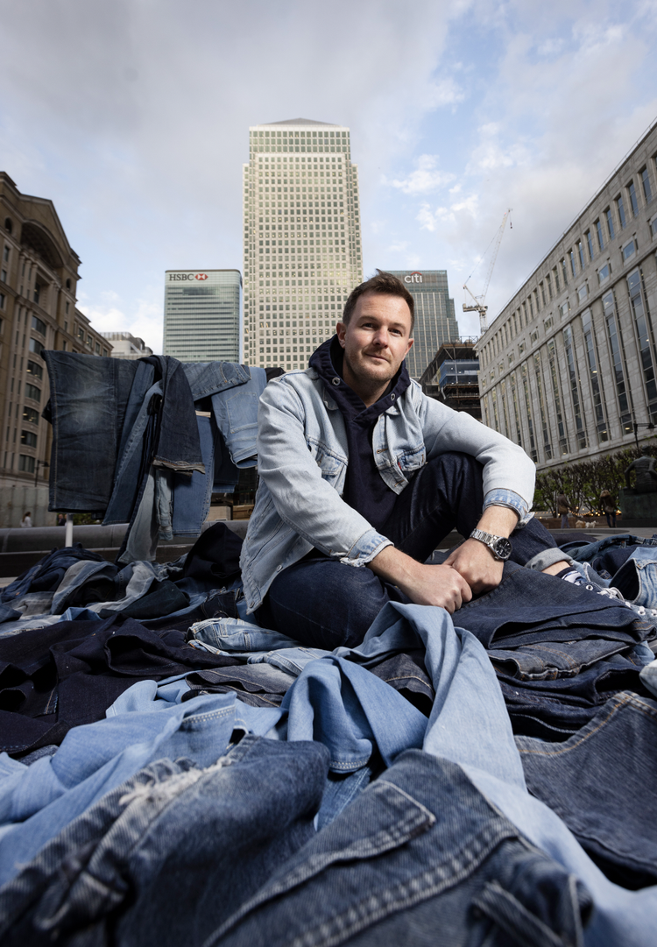
Ian Berry
Art in Denim

Slide 8
CBQ upcycling
Submissions/discussion

Slide 9
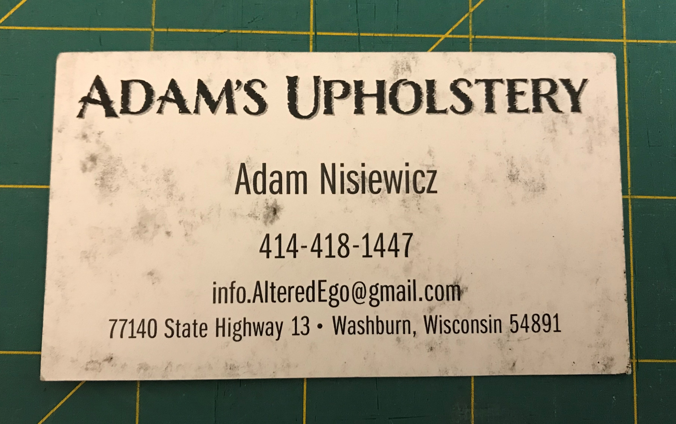

Slide 11
Rules
Do not hand, give or gift hearts to people. (Hearts need to be “found.”)
Do not leave hearts on personal or private property, such as a front porch, vehicle, door, bicycle, mailbox, gate, little libraries, etc. (Not random)
Do not leave hearts in places that are not public: hotel rooms, work desk, break rooms, office, private retreat, etc. (Not public )
Do not leave hearts inside any kind of retail store or on retail displays. (Can be mistaken for merchandise.)
Do not leave hearts in airports. (Homeland security does not approve!)
Do not leave hearts in National Parks or National Wilderness areas. (Federal Regulation Title 36, 2.22 (a))
Do not leave hearts in bathrooms, restrooms, washrooms, etc. (Unsanitary)
Do not leave in places where they may be thrown away by staff. (Super Sad)

Slide 12
Guidelines for sewing
No pattern – about the size of your palm.
Do not add additional words or statements – printable tag only.
Do not give to anyone specific – random project
No clues
No additional pockets/gifts

Slide 13
Good places to sow hearts
local park
hiking trail
highway rest stop
community center
outdoor shopping center
town square
foyer of public place
community bulletin board
beach
nature trail
museum
tourist attraction
trees, bushes and fences in downtown area
Be imaginative and creative when looking for just the right public place to sow a heart and have fun

Slide 14
https://www.ifoundaquiltedheart.com/category/other/ifaqh/

